Slide 1
Traveling Salesman
Bryden Mollenauer
Alex Milanese

Slide 2
The Traveling Salesman Problem
The TSP is finding the shortest hamiltonian cycle in a complete undirected graph starting at the given first node and ending at the same node.

Slide 3

Inputs/Outputs
For input the first line is the number of vertices and then the number of edges and then every line after that is an edge going from the first letter to the second letter and then the number is the weight of the edge. The inputs will make an undirected complete graph. For test case generation i chose values from 1-100 and randomized them for each edge weight while running double for loop to add the value to each edge combination.
12
a b c a

Slide 4
Certifier Process
We know that the certifier process is polynomial because if someone handed me a graph and said this is the shortest path i can prove if it is or isn't with the tsp algorithm and if i increase the sample size by one the run time will double.

Slide 5
Why is the problem important
This problem is important so delivery companies can find the shortest path to take on their routes. If amazon can make it so their trucks spend less gas and take a shorter route they can deliver more product a day for less money while making them more money.

Slide 6
Np Hard Reduction
Our Reduction is taking the hamiltonian cycle problem and reduce it to the Traveling Salesman Problem.
Hamiltonian Cycle Input
TSP
Input
Hamiltonian Cycle Solution

Slide 7
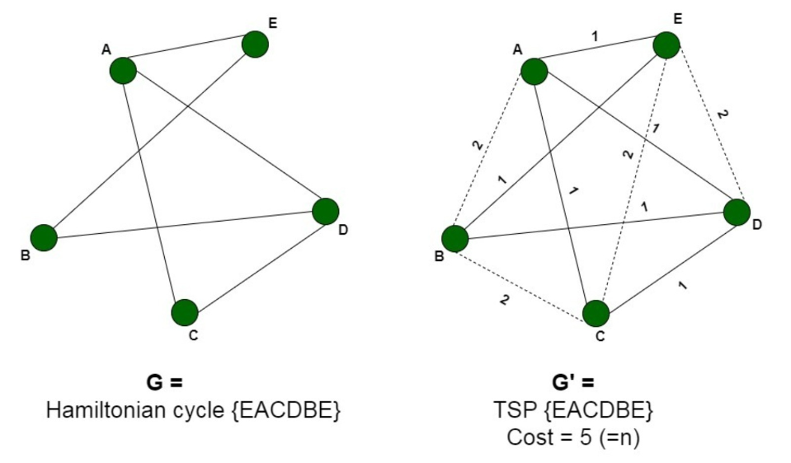
NP hard Reduction
A known NP hard problem is finding a Hamiltonian Cycle
For every HC there is a graph that can be converted to a TSP problem just by my making it complete
This can be done in polynomial time just by adding edges and weights

Slide 8

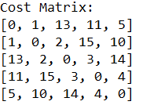
Code explanation
For reading the input i am creating a Cost matrix which looks like this
Input for explanation
5 vertices
10 edges(v(v-1))/2
Each row and column represent the weight of the edge to to get the vertice row and the vertice column

Slide 9
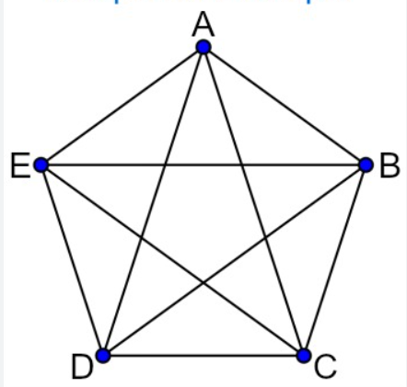
Solution Visualized
Solution will go around in a circle because that is the shortest path
The code will check every single subset

Slide 10
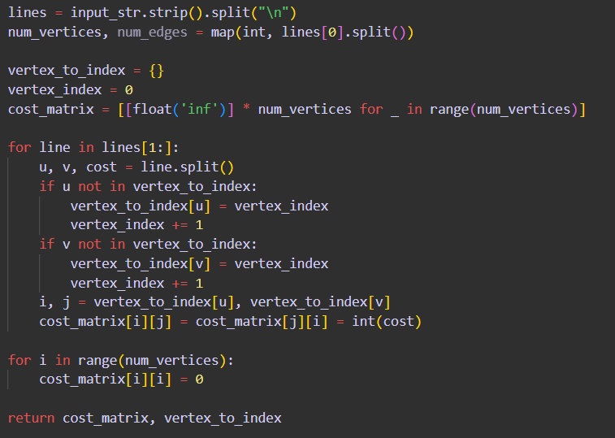
Code for matrix
Creates a dictionary of all the vertices and their index
Create cost matrix size
Then fill the cost matrix using the vertices index and the weight to the edge between the vertices

Slide 11
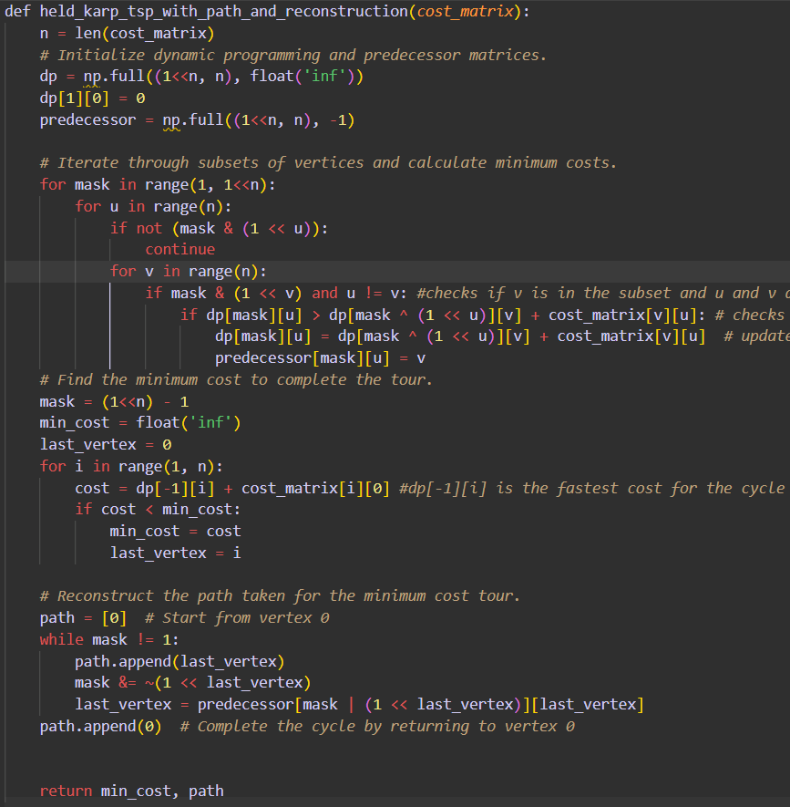
Held_Karp
*makes 2 2d arrays
*goes through the mask
* check individual every possible Subset of vertice paths and records the cost of each path in the dp 2d array
* Then calculates the fast path and backtracks through the predecessor 2d array to return the final path

Slide 12
The mask
The bit mask is a string of ones and zeros and the max length is the number of vertices in the graph. Each iteration of the loop increase the length of the mask by one.
0b1
1000
1001
1010
1011
1100
1101
1110
1111
10000
Starts at 0 slowly adds length and records the total cost of traversal of each possible vertice it is currently looking at

Slide 13
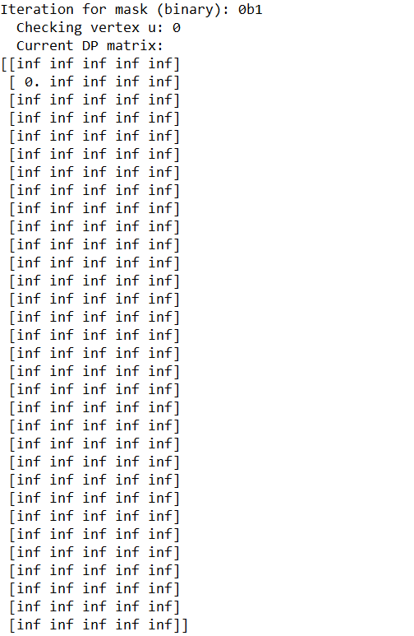
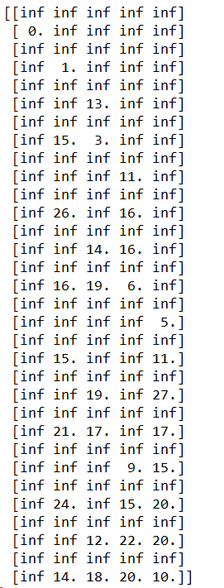
The dp tables
There are 2^n rows in each table
Each row represents each mask iteration
To get the shortest path you can Visually look the last row and pick the lowest number and add the cost of the subset path and the weight of the edge to the starting vertice from the ending vertice so it creates a cycle.

Slide 14
Big O analysis
The dominant term in my code is the Held Karp algorithm implementation
The outer loop goes over every possible subset of vertices which is 2^n long
Then the inner loop goes over every pair of vertices
So overall the Big O is (n^2 * 2^n) runtime

Slide 15
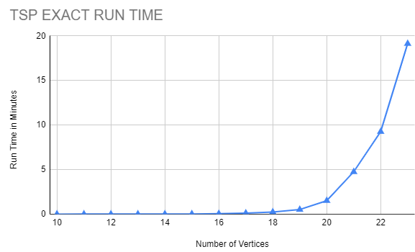
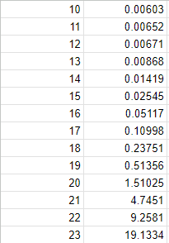
Wall Clock analysis
With smaller inputs the program runs almost instantaneously but once we get to 15+ vertices the program will start to double in time.

